Slide 1

Introduction to Computer Science
Day 1

Slide 2

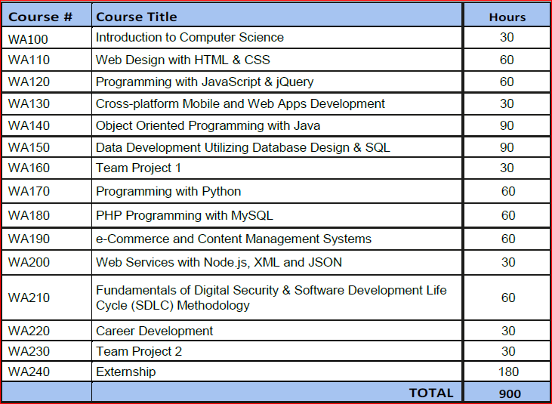
Web Application Design and Development Program Overview

Slide 3
The Definition of Computer Science
Computer science is the study of algorithms, including:
Their formal and mathematical properties
Their hardware realizations
Their linguistic realizations
Their applications
Algorithm
Informally, “an ordered sequence of instructions that is guaranteed to solve a specific problem.”
Operations used to construct algorithms
Sequential operations
Conditional operations
Iterative operations

Slide 4
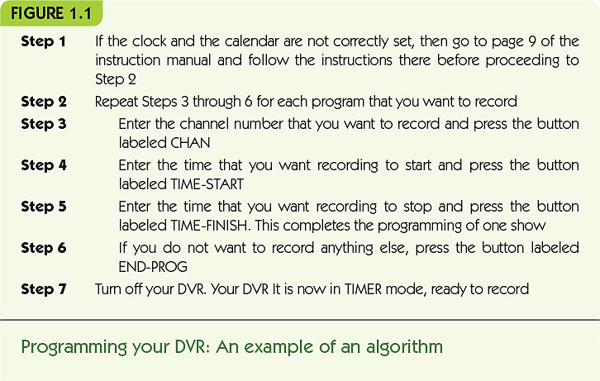

Slide 5
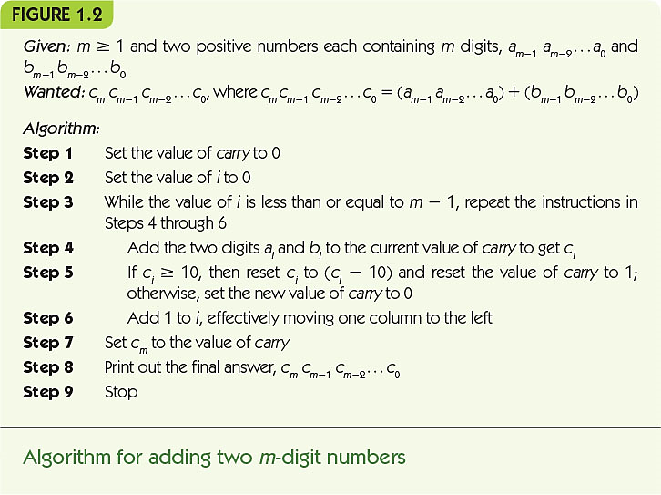

Slide 6
The Definition of Computer Science (continued)
Why are formal algorithms so important in computer science?
If we can specify an algorithm to solve a problem, then we can automate its solution
Computing agent
Machine, robot, person, or thing carrying out the steps of the algorithm
Unsolved problems
Some problems are unsolvable, some solutions are too slow, and some solutions are not yet known

Slide 7
Algorithms
The Formal Definition of an Algorithm
A well-ordered collection of unambiguous and effectively computable operations that, when executed, produces a result and halts in a finite amount of time.
Well-ordered collection
Upon completion of an operation we always know which operation to do next
Ambiguous statements
Go back and do it again (Do what again?)
Start over (From where?)

Slide 8
Algorithms (continued)
Unambiguous operation, or primitive
Can be understood by the computing agent without having to be further defined or simplified
It is not enough for an operation to be understandable
It must also be doable (effectively computable) by the computing agent

Slide 9
Algorithms (continued)
Algorithm
Result must be produced after the execution of a finite number of operations
Result may be a number, text, a light, picture, sound, or a change in the computing agent’s environment
Infinite loop
Runs forever
Usually a mistake

Slide 10
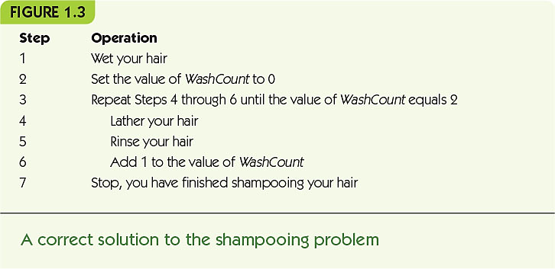

Slide 11
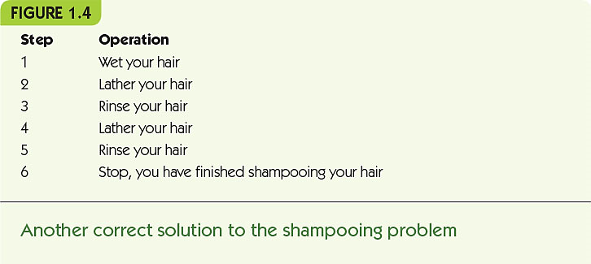

Slide 12
Algorithms (continued)
The Importance of Algorithmic Problem Solving
“Industrial revolution” of 19th century
Mechanized and automated repetitive physical tasks
“Computer revolution” of the 20th and 21st centuries
Mechanized and automated repetitive mental tasks
Through algorithms and computer hardware

Slide 13
A Brief History of Computing The Early Period: Up to 1940
Seventeenth century: automation/simplification of arithmetic for scientific research
John Napier invented logarithms as a way to simplify difficult mathematical computations (1614)
The first slide rule appeared around 1622
Blaise Pascal designed and built a mechanical calculator named the Pascaline (1672)
Gottfried Leibnitz constructed a mechanical calculator called Leibnitz’s Wheel (1674)

Slide 14
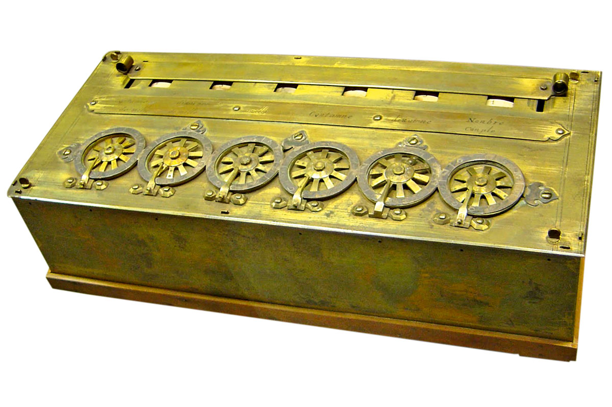
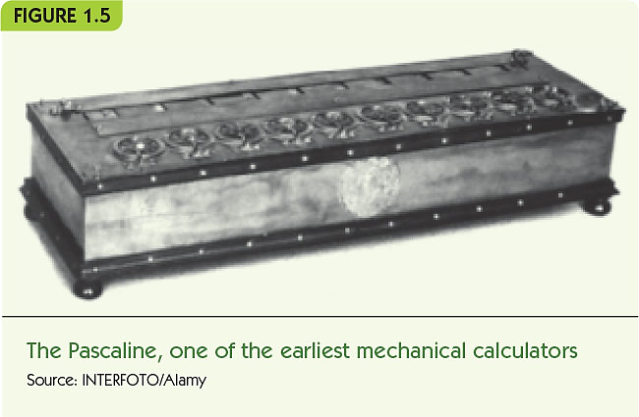

Slide 15
A Brief History of Computing The Early Period: Up to 1940 (continued)
Seventeenth century devices
Could represent numbers
Could perform arithmetic operations on numbers
Did not have a memory to store information
Were not programmable (a user could not provide a sequence of actions to be executed by the device)

Slide 16
A Brief History of Computing The Early Period: Up to 1940 (continued)
Nineteenth century devices
Joseph Jacquard designed an automated loom that used punched cards to create patterns (1801)
Herman Hollerith (1880s on)
Designed programmable card-processing machines to read, tally, and sort data on punched cards for the U.S. Census Bureau
Founded company that became IBM in 1924
Recommended reading:
IBM and the Holocaust
by Edwin Black

Slide 17
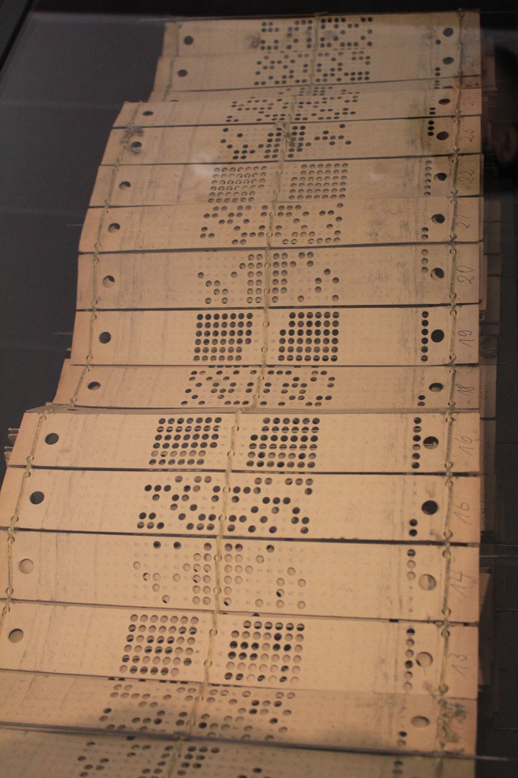
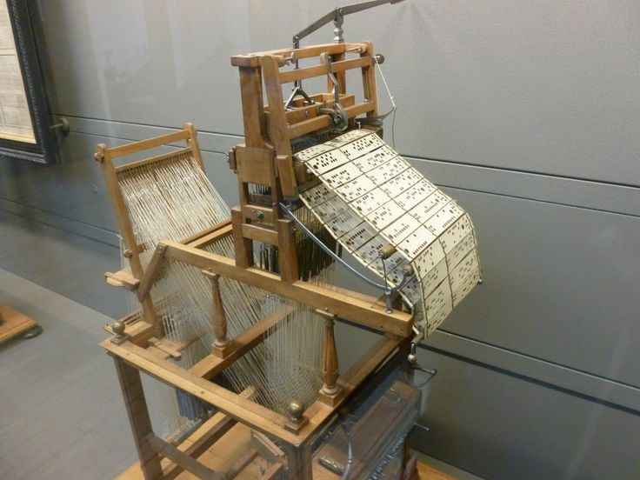
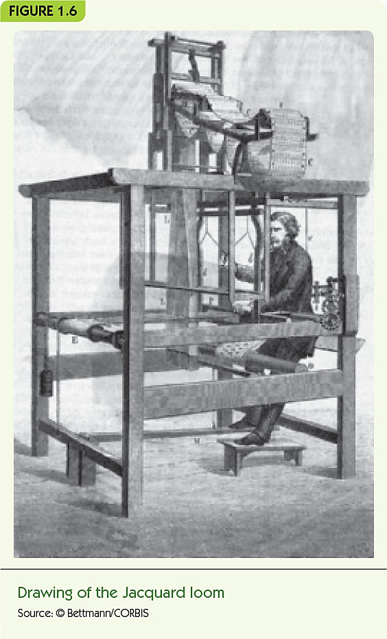

Slide 18
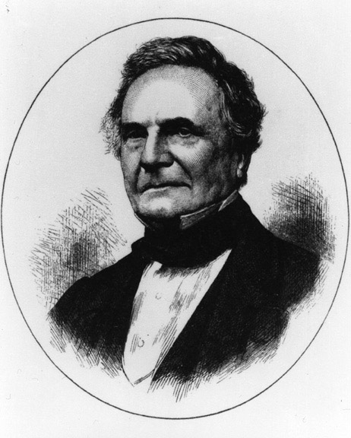
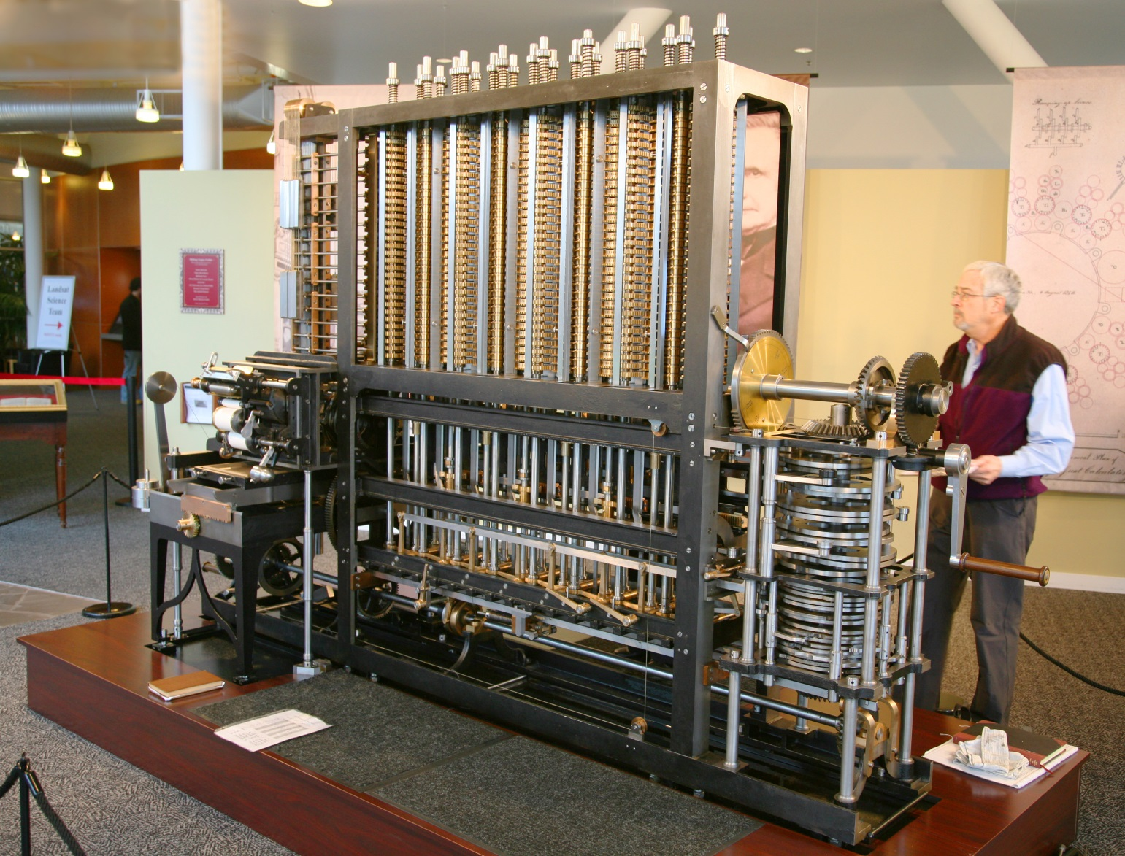
A Brief History of Computing The Early Period: Up to 1940 (continued)
Charles Babbage
Difference Engine designed and built in 1823
Could do addition, subtraction, multiplication, and division to six significant digits
Could solve polynomial equations and other complex mathematical problems
Analytical Engine, designed but never built
Mechanical, programmable machine similar to a modern computer

Slide 19
A Brief History of Computing The Early Period: Up to 1940 (continued)
Nineteenth century devices
Were mechanical, not electrical
Had many features of modern computers:
Representation of numbers or other data
Operations to manipulate the data
Memory to store values in a machine-readable form
Programmable: sequences of instructions could be pre-designed for complex operations

Slide 20
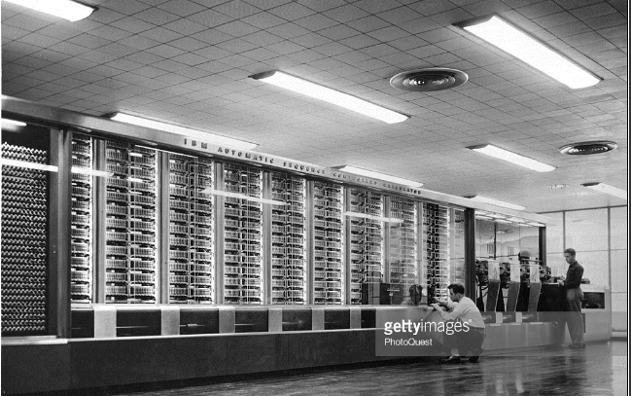
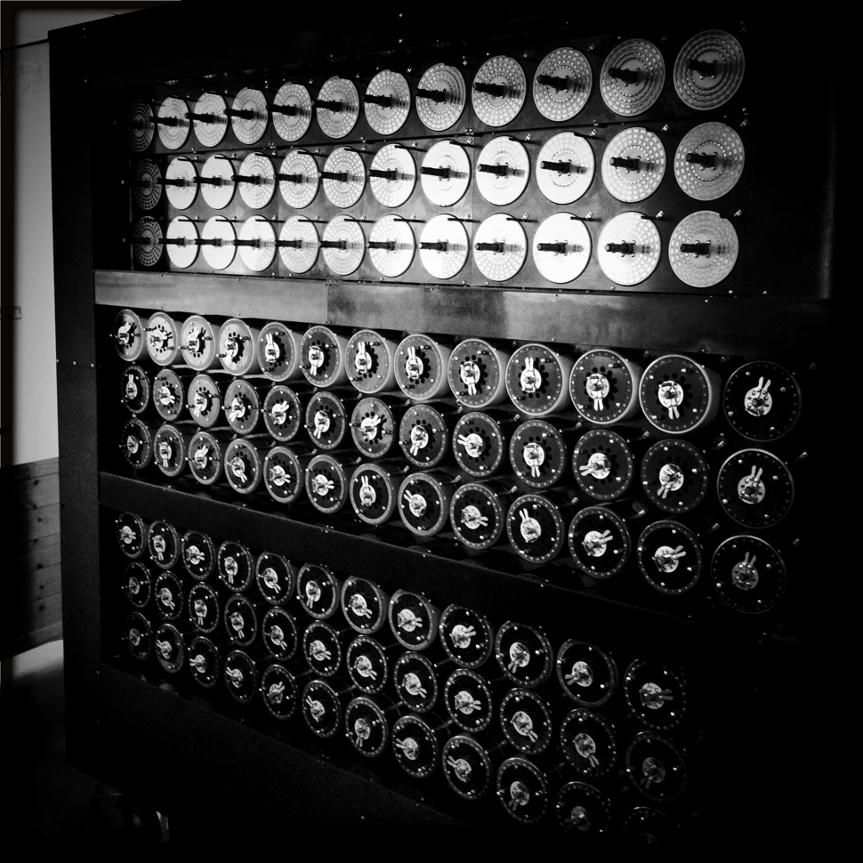
A Brief History of Computing The Birth of Computers: 1940–1950
Harvard Mark 1
Mark I (1944)
Electromechanical computer used a mix of relays, magnets, and gears to process and store data
Colossus (1943)
General-purpose computer built by Alan Turing for British Enigma project
ENIAC (Electronic Numerical Integrator and Calculator) (1946)
First publicly known fully electronic computer

Slide 21
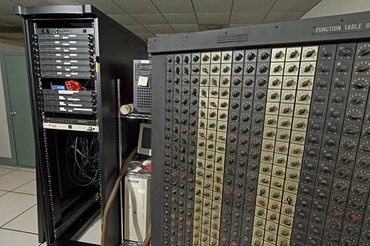
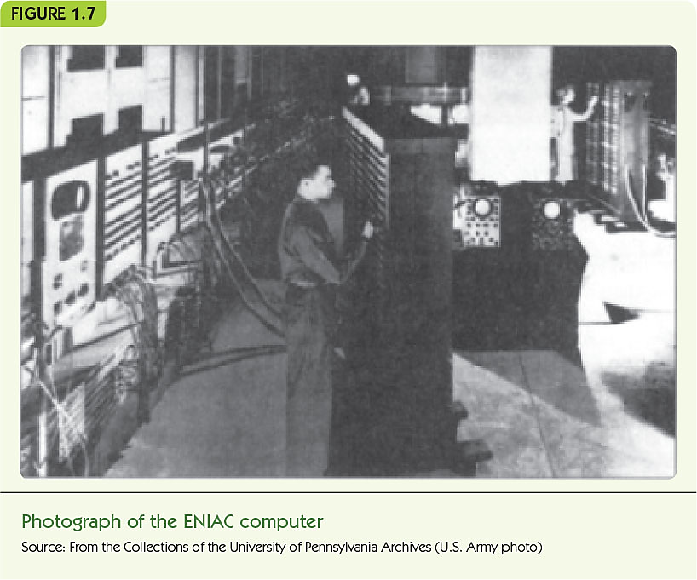
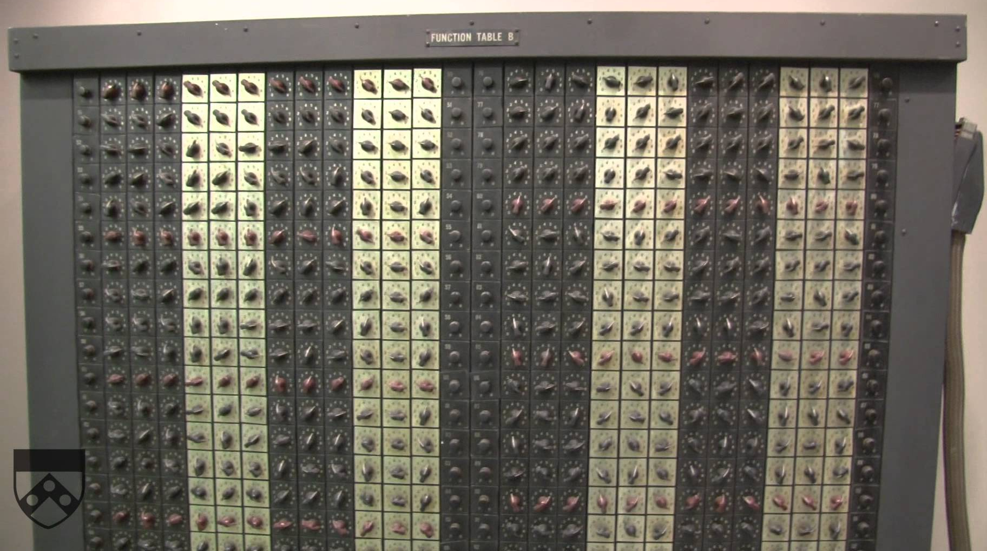

Slide 22
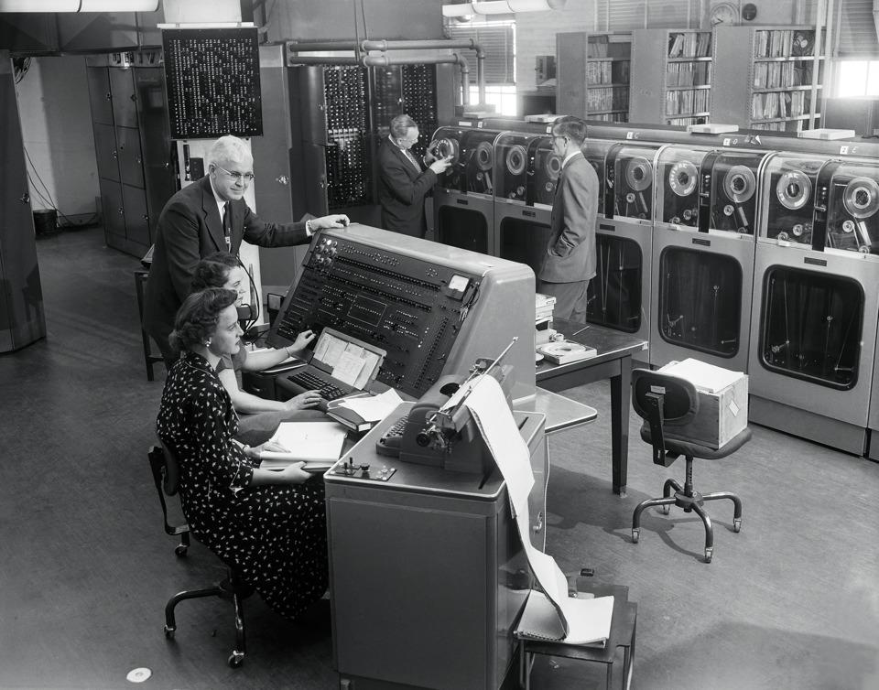
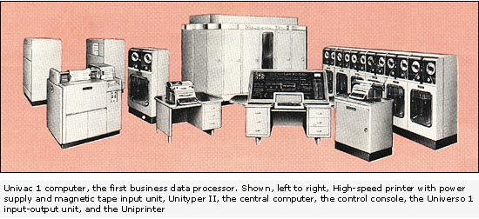
A Brief History of Computing The Birth of Computers: 1940–1950 (continued)
John Von Neumann
Proposed a radically different computer design based on a model called the stored program computer
Research group at the University of Pennsylvania built one of the first stored program computers, called EDVAC, in 1951
UNIVAC-1, a version of EDVAC, first commercially-sold computer
Virtually all modern computers use the Von Neumann architecture

Slide 23
A Brief History of Computing The Modern Era: 1950 to the Present
First generation of computing (1950-1957)
Similar to EDVAC
Vacuum tubes for processing and storage
Large, expensive, and delicate
Required trained users and special environments
Second generation (1957–1965)
Transistors and magnetic cores instead of vacuum tubes
Era of FORTRAN and COBOL: high-level programming languages

Slide 24
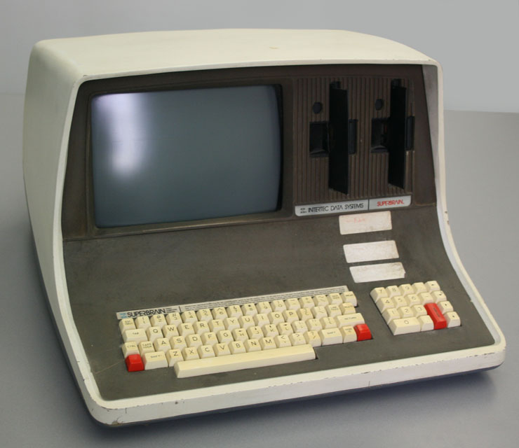
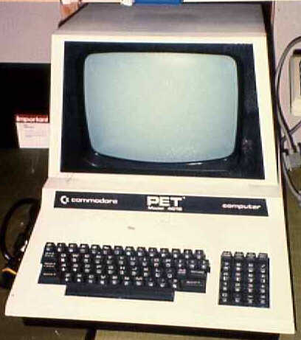
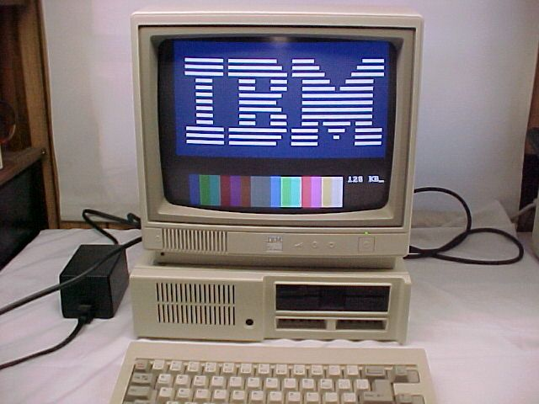
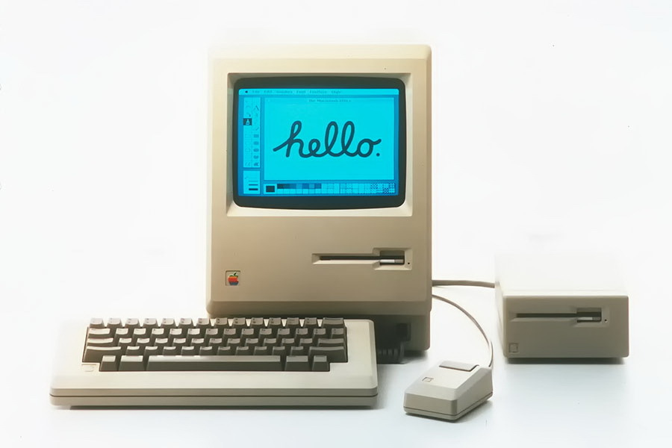
A Brief History of Computing The Modern Era: 1950 to the Present (continued)
Third generation (1965 to 1975)
Era of the integrated circuit
Birth of the first minicomputer: desk-sized, not room-sized computers
Birth of the software industry
Fourth generation (1975 to 1985)
The first microcomputers: desktop machines
Development of widespread computer networks
Electronic mail, graphical user interfaces, and embedded systems

Slide 25
A Brief History of Computing The Modern Era: 1950 to the Present (continued)
Fifth generation (1985–?)
Massively parallel processors capable of quadrillions (10¹⁵) of computations per second
Handheld digital devices
Powerful multimedia user interfaces incorporating sound, voice recognition, images, video, television
Wireless communications
Massive storage devices
Ubiquitous computing

Slide 26
Summary
Computer science is the study of algorithms
An algorithm is a well-ordered collection of unambiguous and effectively computable operations that, when executed, produces a result and halts in a finite amount of time
If we can specify an algorithm to solve a problem, then we can automate its solution
Computers developed from mechanical calculating devices to modern electronic marvels of miniaturization

Slide 27
Algorithm Discovery and Design

Slide 28
Representing Algorithms
Pseudocode is used to design algorithms
Natural language is:
Expressive, easy to use
Verbose, unstructured, and ambiguous
Programming languages are:
Structured, designed for computers
Grammatically fussy, cryptic
Pseudocode lies somewhere between these two

Slide 29
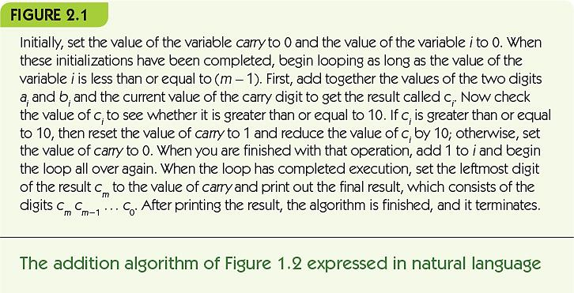

Slide 30
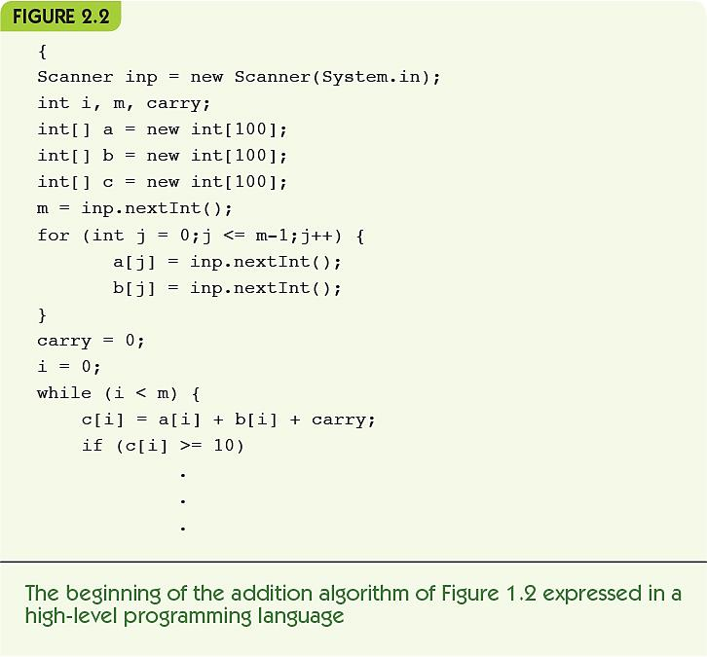

Slide 31
Representing Algorithms (cont'd)
Sequential operations perform a single task
Computation: a single numeric calculation
Input: gets data values from outside the algorithm
Output: sends data values to the outside world
A variable is a named location to hold a value
A sequential algorithm is made up only of sequential operations
Input
Outside World
Computing Agent
Output

Slide 32
Representing Algorithms (cont'd)
Let’s see an example of a variable:
Set the value of carry to 0
“Arithmetic expression” is a constant value of ZERO
That result is stored in a variable called CARRY
If CARRY had a previous value, it will now be replaced by ZERO.
If CARRY did not yet have a value, it does now: ZERO.

Slide 33
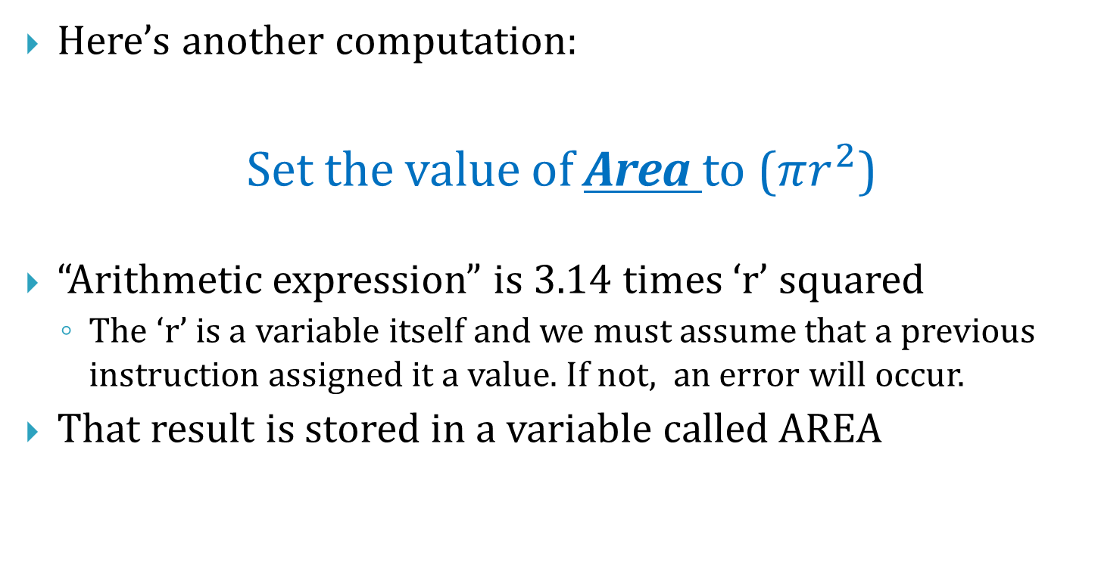
Representing Algorithms (cont'd)
Here’s another computation:
Set the value of Area to ($πr^{2}$)
“Arithmetic expression” is 3.14 times ‘r’ squared
The ‘r’ is a variable itself and we must assume that a previous instruction assigned it a value. If not, an error will occur.
That result is stored in a variable called AREA

Slide 34
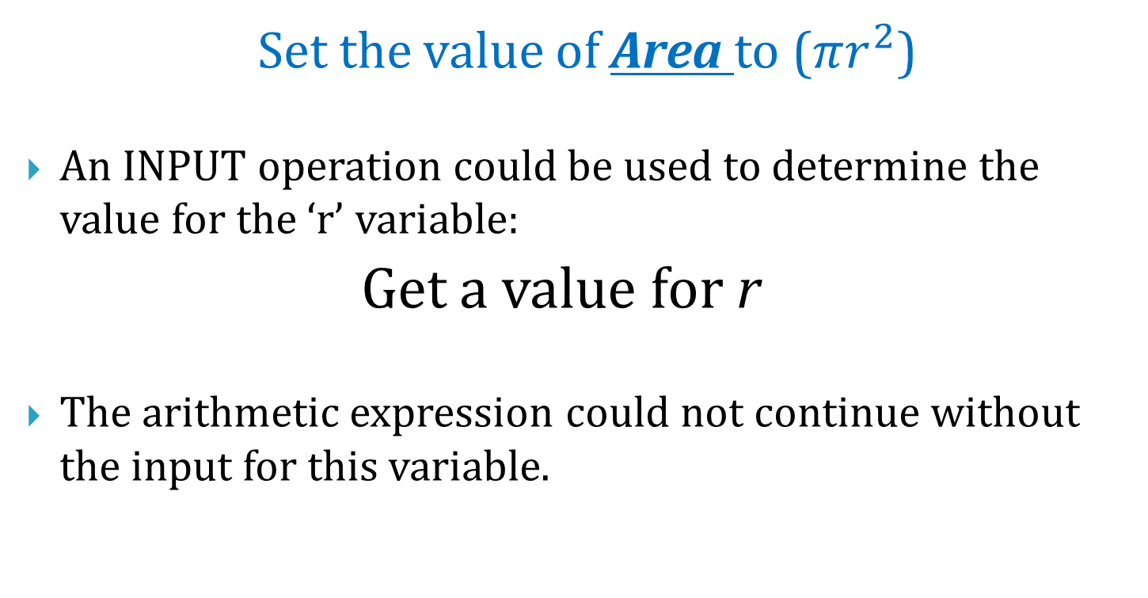
Representing Algorithms (cont'd)
Set the value of Area to ($πr^{2}$)
An INPUT operation could be used to determine the value for the ‘r’ variable:
Get a value for r
The arithmetic expression could not continue without the input for this variable.

Slide 35
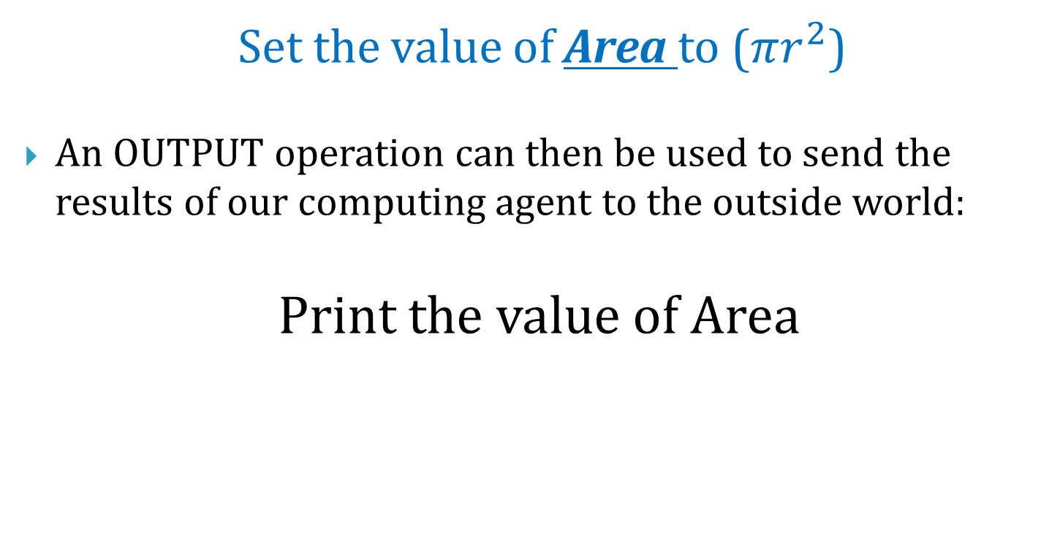
Representing Algorithms (cont'd)
Set the value of Area to ($πr^{2}$)
An OUTPUT operation can then be used to send the results of our computing agent to the outside world:
Print the value of Area

Slide 36
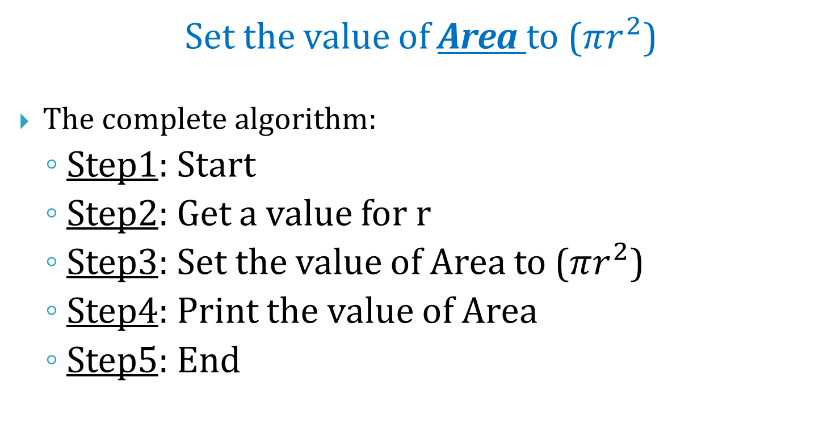
Representing Algorithms (cont'd)
Set the value of Area to ($πr^{2}$)
The complete algorithm:
Step1: Start
Step2: Get a value for r
Step3: Set the value of Area to ($πr^{2}$)
Step4: Print the value of Area
Step5: End

Slide 37
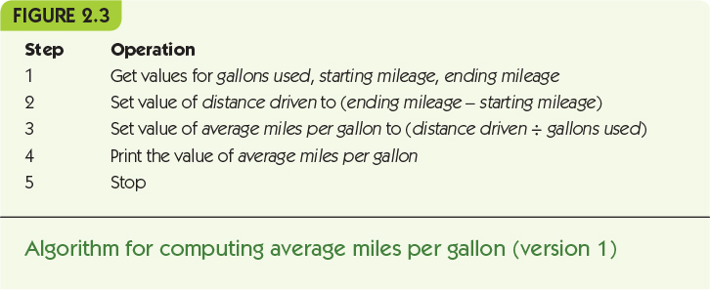

Slide 38
Representing Algorithms (cont'd)
Control operation: changes the normal flow of control
Conditional statement: asks a question and selects among alternative options
Evaluate the true/false condition
If the condition is true, then do the first set of operations and skip the second set
If the condition is false, skip the first set of operations and do the second set
Example: check for good or bad gas mileage

Slide 39
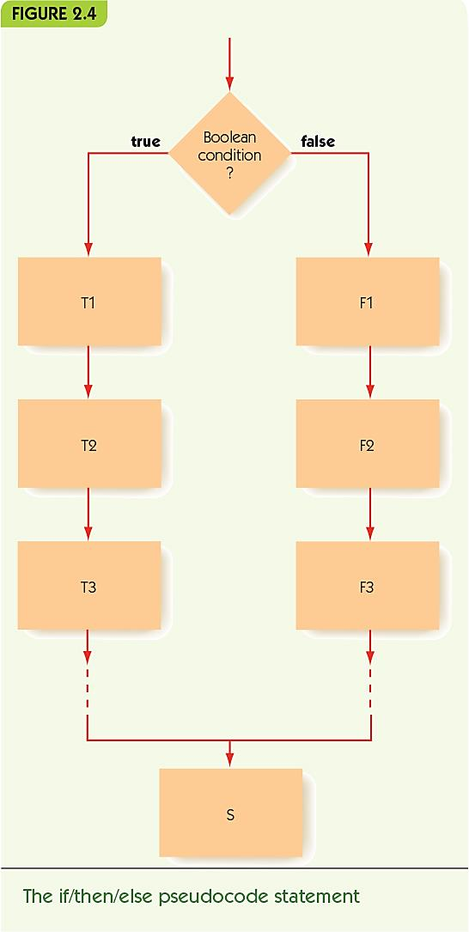
Note: A Boolean condition is a condition with only two possible outcomes: true or false

Slide 40
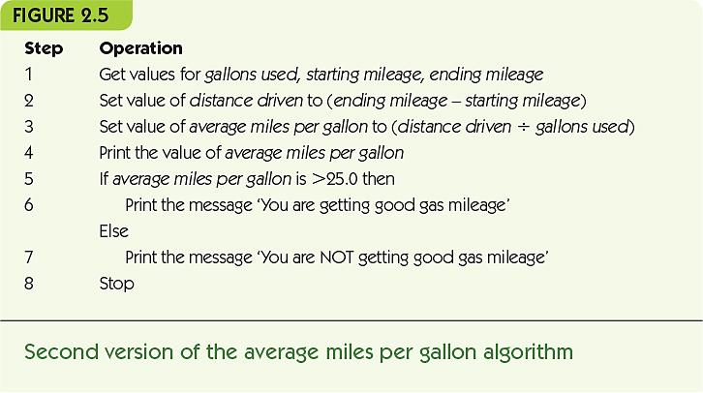

Slide 41
Representing Algorithms (cont'd)
Iteration: an operation that causes looping, repeating a block of instructions. Iteration is defined as the act or process of repeating. A “While Statement” repeats while a condition remains true.
Continuation condition: a test to see if while loop should continue.
Loop body: instructions to perform repeatedly.
Note: When writing algorithms, operations within the loop body are usually indented so that it is clear to the reader which operations belong outside of the loop.

Slide 42
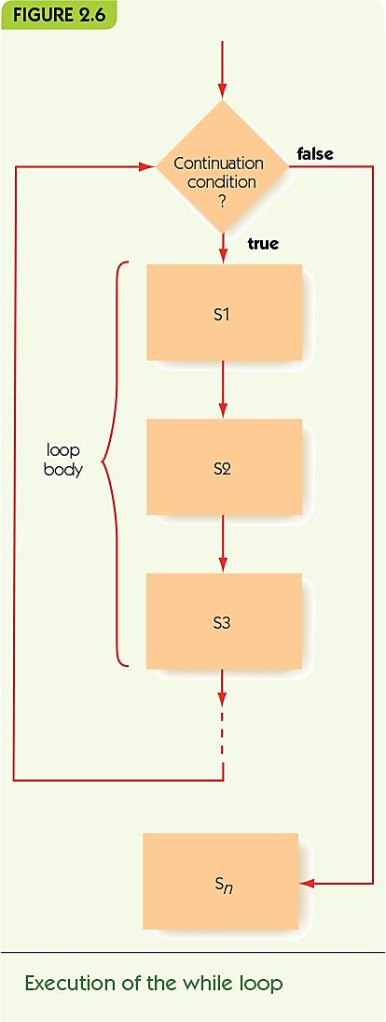

Slide 43
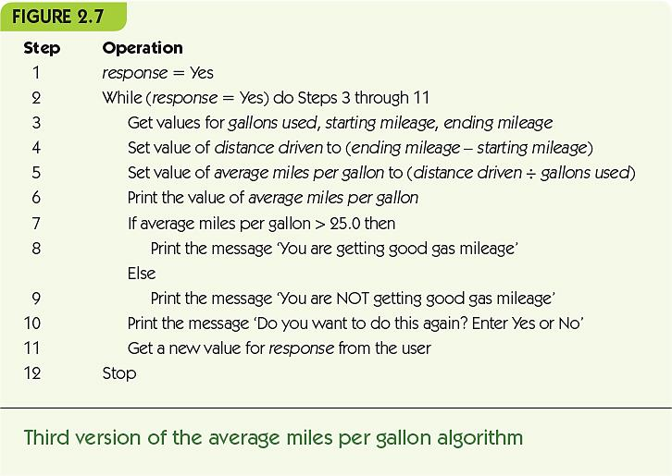

Slide 44
Representing Algorithms (cont'd)
“Do/while”, alternate iterative operation.
Continuation condition appears at the end.
Loop body always performed at least once.
Examples:
while your game character is level 1, she can only do 5 points damage.
while you press the accelerator, you do drive.
while the timer is running, the timer counter is progressing...
Primitive operations: sequential, conditional, and iterative are all that is needed.

Slide 45
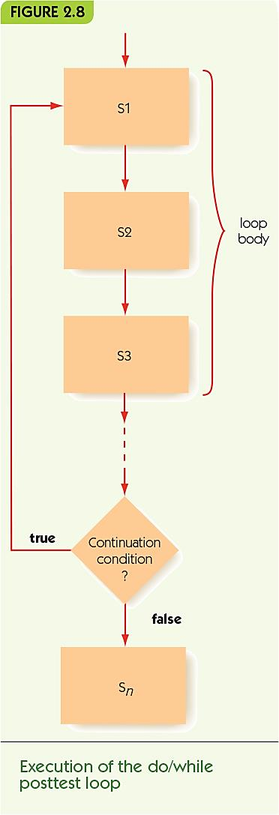

Slide 46
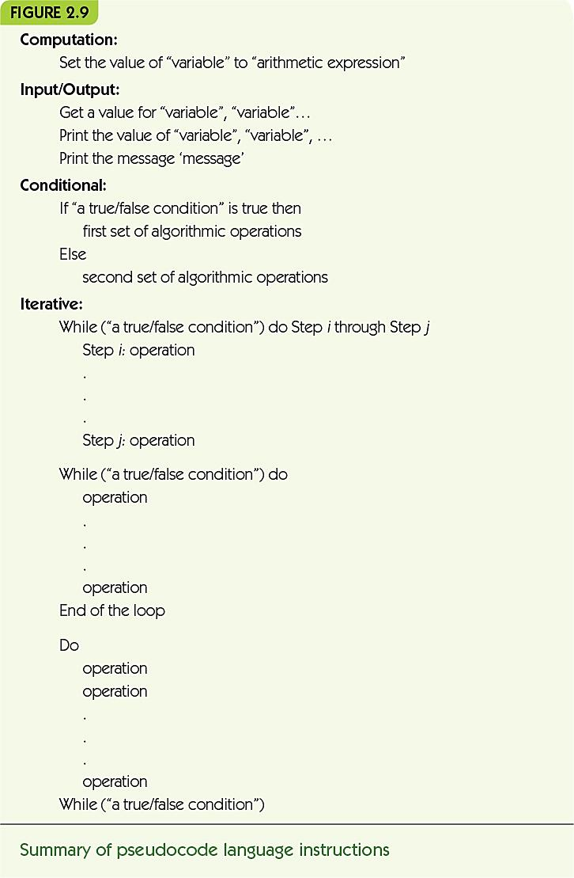

Slide 47
Examples of Algorithmic Problem Solving Example 1: Go Forth and Multiply
“Given two nonnegative integer values, a ≥ 0, b ≥ 0, compute and output the product (a × b) using the technique of repeated addition. That is, determine the value of the sum a + a + a + . . . + a (b times).”

Slide 48
Examples of Algorithmic Problem Solving Example 1: Go Forth and Multiply (cont'd)
Get input values
Get values for a and b
Compute the answer
Loop b times, adding each time*
Output the result
Print the final value*
* steps need elaboration

Slide 49
Examples of Algorithmic Problem Solving Example 1: Go Forth and Multiply (cont'd)
Loop b times, adding each time
Get values for a and b
Set the value of count to 0
While (count < b) do
… the rest of the loop*
Set the value of count to count + 1
End of loop
* steps need elaboration

Slide 50
Examples of Algorithmic Problem Solving Example 1: Go Forth and Multiply (cont'd)
Loop b times, adding each time
Get values for a and b
Set the value of count to 0
Set the value of product to 0
While (count < b) do
Set the value of product to (product + a)
Set the value of count to count + 1
End of loop
Output the result
Print the value of product

Slide 51
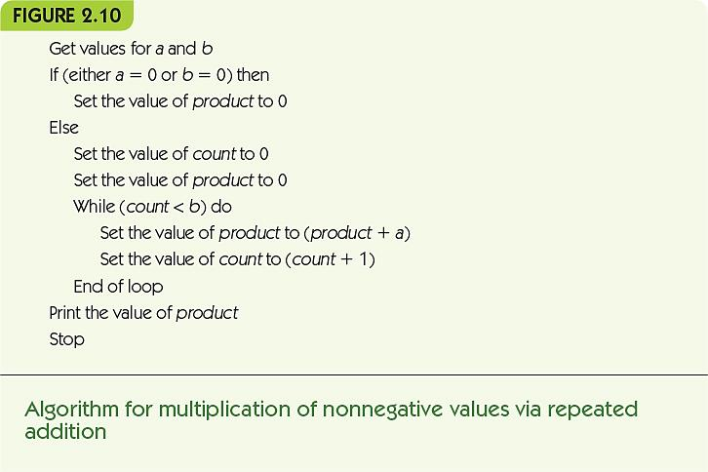

Slide 52
Examples of Algorithmic Problem Solving Example 2: Looking, Looking, Looking
“Assume that we have a list of 10,000 names that we define as N₁, N₂, N₃, . . . , N_{10,000}, along with the 10,000 telephone numbers of those individuals, denoted as T₁, T₂, T₃, . . . , T_{10,000}. To simplify the problem, we initially assume that all names in the book are unique and that the names need not be in alphabetical order.”

Slide 53
Examples of Algorithmic Problem Solving Example 2: Looking, Looking, Looking (cont'd)
Three versions here illustrate algorithm discovery, working toward a correct, efficient solution
A sequential algorithm (no loops or conditionals)
An incomplete iterative algorithm
A correct algorithm

Slide 54
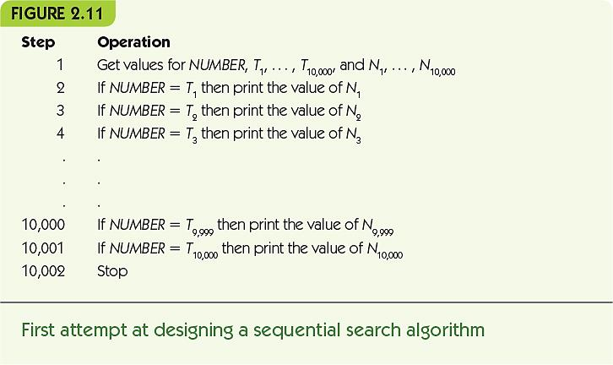

Slide 55
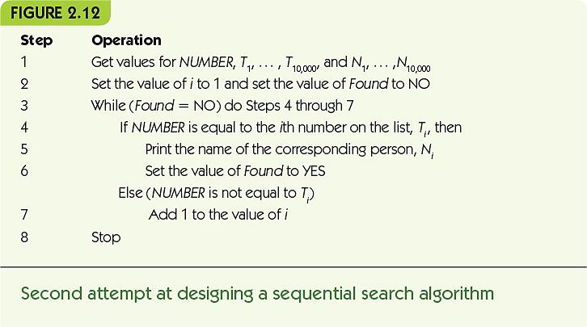

Slide 56
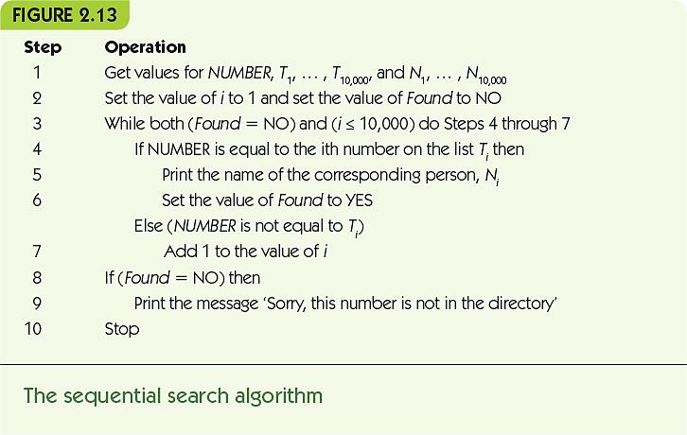

Slide 57
Examples of Algorithmic Problem Solving Example 3: Big, Bigger, Biggest
A “building-block” algorithm used in many libraries
Library: A collection of pre-defined useful algorithms
“Given a value n ≥ 1 and a list containing exactly n unique numbers called A₁, A₂, . . . , A_{n}, find and print out both the largest value in the list and the position in the list where that largest value occurred.”

Slide 58
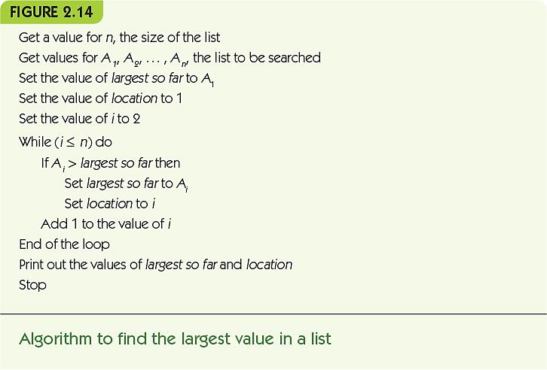

Slide 59
Examples of Algorithmic Problem Solving Example 4: Meeting Your Match
Pattern-matching: common across many applications, such as:
Word processor search, web search, image analysis, and human genome project
“You will be given some text composed of n characters that will be referred to as T₁ T₂ . . . T_{n}. You will also be given a pattern of m characters, m ≤ n, that will be represented as P₁ P₂ . . . P_{m}. The algorithm must locate every occurrence of the given pattern within the text. The output of the algorithm is the location in the text where each match occurred.”

Slide 60
Examples of Algorithmic Problem Solving Example 4: Meeting Your Match (cont'd)
Algorithm has two parts:
Sliding the pattern along the text, aligning it with each position in turn
Given a particular alignment, determine if there is a match at that location
Solve parts separately and use
Abstraction, focus on high level, not details
Top-down design, start with big picture, gradually elaborate parts

Slide 61
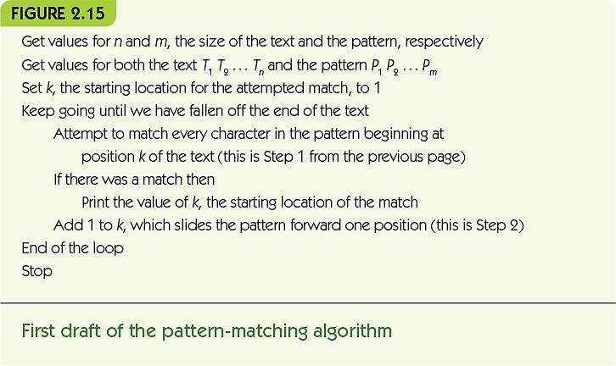

Slide 62
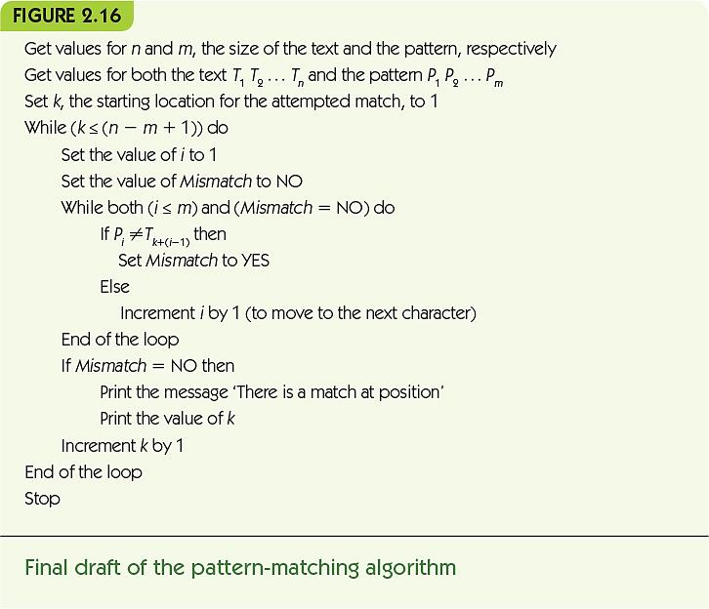

Slide 63
Summary
Pseudocode is used for algorithm design: structured like code, but allows English and math phrasing and notation
Pseudocode is made up of: sequential, conditional, and iterative operations
Algorithmic problem solving involves:
Step-by-step development of algorithm pieces
Use of abstraction, and top-down design

Slide 64
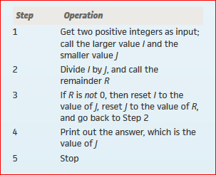
Exercises
1. Identify some algorithms, apart from DVR instructions and cooking recipes, that you encounter in your everyday life. Write them out in any convenient notation, and explain how they meet all the criteria for algorithms presented in this chapter. Think of algorithms that include conditional logic and repetitive tasks.
2. Write an algorithm that gets the price for item A plus the quantity purchased. The algorithm prints the total cost, including a 8% sales tax.
3. Develop an algorithm to compute gross pay. The inputs to your algorithm are the hours worked per week and the hourly pay rate. The rule for determining gross pay I s to pay the regular pay rate for all hours worked up to 40, time and a half for all hours over 40 up to 54, and double time for all hours over 54. Compute and display the value for gross pay using this rule. After displaying one value, ask the user whether he or she wants to do another computation. Repeat the entire set of operations until the user says no.
4. The following is Euclid’s 2,300-year-old algorithm for finding the greatest common divisor of two positive integers I and J.
Go through this algorithm using the input values 20 and 32. After each step of the algorithm is completed, give the values of I, J, and R. Determine the final output of the algorithm.
Does the algorithm work correctly when the two inputs are 0 and 32? Describe exactly what happens, and modify the algorithm so that it gives an appropriate error message.

Slide 65
The Efficiency of Algorithms

Slide 66
Introduction
Many solutions to any given problem
How can we judge and compare algorithms?
Metaphor: purchasing a car
Ease of handling
Style
Fuel efficiency
Evaluating an algorithm
Ease of understanding
Elegance
Time/space efficiency

Slide 67
Attributes of Algorithms
Attributes of interest: correctness, ease of understanding, elegance, and efficiency
Correctness
Is the problem specified correctly?
Does the algorithm produce the correct result?
Example: pattern matching
Problem spec: “given pattern p and text t, determine the location, if any, of pattern p occurring in text t”
Algorithm correct: does it always work?

Slide 68
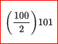
Attributes of Algorithms (cont'd)
Ease of understanding, useful for:
Checking correctness
Program maintenance
Elegance: using a clever or non-obvious approach
Attributes may conflict: elegance often conflicts with ease of understanding
Attributes may reinforce each other: ease of understanding supports correctness
Elegance is the algorithmic equivalent of style. The classic example, in mathematical folklore, is the story of the German mathematician Karl Frederick Gauss (1777–1855), who was asked as a schoolchild to add up the numbers from 1 to 100. The straightforward algorithm is adding 1 + 2 + 3 + 4 + . . . + 100, i.e. adding one number at a time, resulting in 5,050. However, Gauss noticed that the numbers from 1 to 100 could be grouped into 50 pairs of the form
1 + 100 = 101
2 + 99 = 101
…
50 + 51 = 101
so that the sum equals 50 x 101 = 5,050 or
Keep IT Simple
27/3/3-1 = 1+1

Slide 69
Attributes of Algorithms (cont'd)
Efficiency: an algorithm’s use of time and space resources
Timing an algorithm is not always useful
Confounding factors: machine speed, size of input
Benchmarking: timing an algorithm on standard data sets
Testing hardware and operating system, etc.
Testing real-world performance limits

Slide 70
Measuring Efficiency Sequential Search
Analysis of algorithms: the study of the efficiency of algorithms.
Searching: the task of finding a specific value in a list of values, or deciding it is not there.
Sequential search algorithm
Given a target value and a random list of values, find the location of the target in the list, if it occurs, by checking each value in the list in turn.

Slide 71
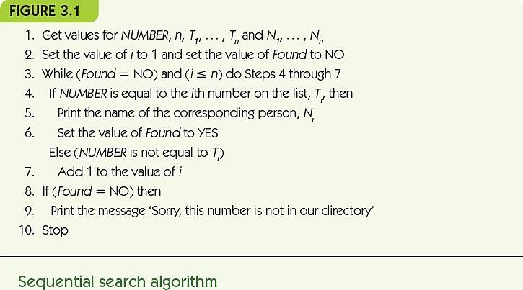

Slide 72
Measuring Efficiency Sequential Search (cont'd)
Central unit of work, operations most important for the task, and occurring frequently
In sequential search, comparison of target NAME to each name in the list
Given a big input list:
Best case is smallest amount of work algorithm does
Worst case is greatest amount of work algorithm does
Average case depends on likelihood of different scenarios occurring

Slide 73
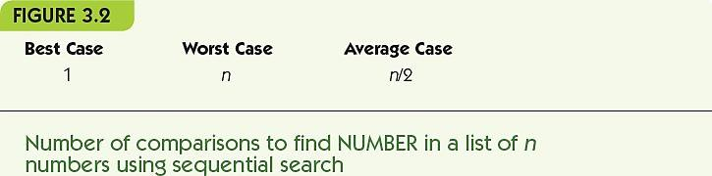
Measuring Efficiency Sequential Search (cont'd)
Best case: target found with the first comparison
Worst case: target never found or last value
Average case: if each value is equally likely to be searched, work done varies from 1 to n, averages to n/2

Slide 74
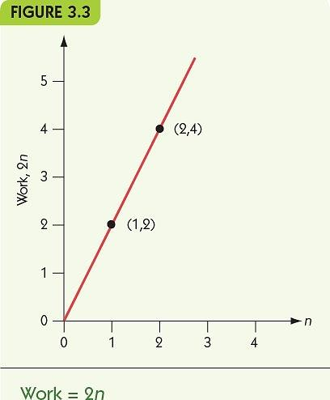
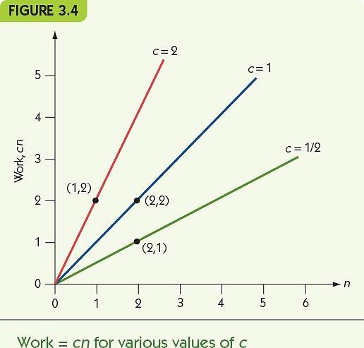
Measuring Efficiency Order of Magnitude—Order n
Order of magnitude n, Θ(n): the set of functions that grow in a linear fashion

Slide 75
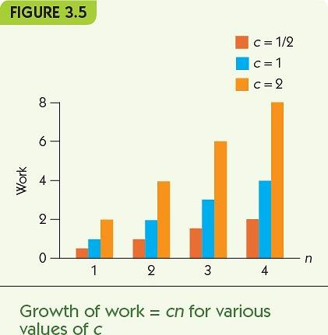
Measuring Efficiency Order of Magnitude—Order n (cont'd)
Change in growth as n increases is constant size

Slide 76
Measuring Efficiency Selection Sort
Sorting: the task of putting a list of values into numeric or alphabetical order
Key idea
Pass repeatedly over the unsorted portion of the list
Each pass select the largest remaining value
Move that value to the end of the unsorted values

Slide 77


Slide 78
Measuring Efficiency Selection Sort (cont'd)
Example: Selection Sort on [5, 1, 3, 9, 4]
Pass 1
Select 9 as the largest in the whole list
Swap with 4 to place in last slot
[5, 1, 3, 4, 9]
Pass 2
Select 5 as the largest in the first four values
Swap with 4 to place in last remaining slot
[4, 1, 3, 5, 9]

Slide 79
Measuring Efficiency Selection Sort (cont'd)
Example: Selection Sort on [5, 1, 3, 9, 4]
Pass 3
Select 4 as the largest in the first three
Swap with 3 to place in last slot
[3, 1, 4, 5, 9]
Pass 4
Select 3 as the largest in the first two values
Swap with 1 to place in last remaining slot
[1, 3, 4, 5, 9]

Slide 80

Measuring Efficiency Selection Sort (cont'd)
Central unit of work: hidden in “find largest” step
Work done to find largest changes as unsorted portion shrinks
(n-1) + (n-2) + … + 2 + 1 = n (n-1) / 2

Slide 81

Measuring Efficiency Order of Magnitude—Order n²
Order n², Θ(n²):
the set of functions
whose growth is on the
order of n²

Slide 82


Measuring Efficiency Order of Magnitude—Order n² (cont'd)
Eventually, every function with order n² has greater values than any function with order n

Slide 83


Slide 84
Analysis of Algorithms Data Cleanup Algorithms
“Given a collection of age data, where erroneous zeros occur, find and remove all the zeros from the data, reporting the number of legitimate age values that remain”
Illustrates multiple solutions to a single problem
Use of analysis to compare algorithms

Slide 85
Analysis of Algorithms Data Cleanup Algorithms (cont'd)
Shuffle-left algorithm
Search for zeros from left to right
When a zero is found, shift all values to its right one cell to the left
Example: [55, 0, 32, 19, 0, 27]
Finds 0 at position 2: [55, 32, 19, 0, 27, 27]
Finds 0 at position 4: [55, 32, 19, 27, 27, 27]

Slide 86


Slide 87
Analysis of Algorithms Data Cleanup Algorithms (cont'd)
Analysis of shuffle-left for time efficiency
Count comparisons looking for zero AND movements of values
Best case: no zeros occur, check each value and nothing more: Θ(n)
Worst case: every value is a zero, move n-1 values, then n-2 values, etc.: Θ(n²)
Analysis of shuffle-left for space efficiency
Uses no significant space beyond input

Slide 88
Analysis of Algorithms Data Cleanup Algorithms (cont'd)
Copy-over algorithm
Create a second, initially empty, list
Look at each value in the original
If it is non-zero, copy it to the second list
Example: [55, 0, 32, 19, 0, 27]
answer = [55] 4. answer = [55, 32, 19]
answer = [55] 5. answer = [55, 32, 19]
answer = [55, 32] 6. answer = [55, 32, 19, 27]

Slide 89


Slide 90
Analysis of Algorithms Data Cleanup Algorithms (cont'd)
Time efficiency for copy-over
Best case: all zeros, checks each value but doesn’t copy it: Θ(n)
Worst case: no zeros, checks each value and copies it: Θ(n)
Space efficiency for copy-over
Best case: all zeros, uses no extra space
Worst case: no zeros, uses n extra spaces

Slide 91
Analysis of Algorithms Data Cleanup Algorithms (cont'd)
Converging-pointers algorithm
Keep track of two pointers at the data
Left pointer moves left to right and stops when it sees a zero value
Right pointer stays put until a zero is found
Then its value is copied on top of the zero, and it moves one cell to the left
Stop when the left crosses the right

Slide 92


Slide 93
Analysis of Algorithms Data Cleanup Algorithms (cont'd)
Example: [55, 0, 32, 19, 0, 27]
[55, 0, 32, 19, 0, 27]
L R
[55, 0, 32, 19, 0, 27]
L R
[55, 27, 32, 19, 0, 27]
L R
[55, 27, 32, 19, 0, 27]
LR

Slide 94
Analysis of Algorithms Data Cleanup Algorithms (cont'd)
Time efficiency for converging-pointers
Best case: no zeros, left pointer just moves across to pass the right pointers, examines each value: Θ(n)
Worst case: all zeros, examines each value and copies a value over it, right pointer moves left towards left pointer: Θ(n)
Space efficiency for converging-pointers
No significant extra space needed

Slide 95


Slide 96
Analysis of Algorithms Binary Search
Binary Search Algorithm
Given a target value and an ordered list of values, find the location of the target in the list, if it occurs, by starting in the middle and splitting the range in two with each comparison

Slide 97


Slide 98
Analysis of Algorithms Binary Search (cont'd)
Example: target = 10, list = [1, 4, 5, 7, 10, 12, 14, 22]
mid = 7, eliminate lower half:
[1, 4, 5, 7, 10, 12, 14, 22]
mid = 12, eliminate upper half:
[1, 4, 5, 7, 10, 12, 14, 22]
mid = 10, value found!

Slide 99
Analysis of Algorithms Binary Search (cont'd)
Central unit of work: comparisons against target
Best case efficiency
Value is the first middle value: 1 comparison
Worst case efficiency
Value does not appear, repeats as many times as we can divide the list before running out of values: Θ(lg n)

Slide 100


Analysis of Algorithms Binary Search (cont'd)
Order of magnitude lg n, Θ(lg n), grows very slowly

Slide 101
Analysis of Algorithms Pattern Matching
Algorithm from chapter 2
Best case: when first symbol of pattern does not appear in text
Worst case: when all but last symbol of pattern make up the text

Slide 103
Analysis of Algorithms Pattern Matching (cont'd)
Best case example
Pattern = “xyz” text = “aaaaaaaaaaaaaaa”
At each step, compare ‘x’ to ‘a’ and then move on
Θ(n) comparisons
Worst case example
Pattern = “aab” text = “aaaaaaaaaaaaaaa”
At each step, compare m symbols from pattern against text before moving on
Θ(mn) comparisons

Slide 104


Slide 105
When Things Get Out of Hand
Polynomially bounded: an algorithm that does work on the order of Θ(n^{k})
Most common problems are polynomially bounded
Hamiltonian circuit is NOT
Given a graph, find a path that passes through each vertex exactly once and returns to its starting point

Slide 106



Slide 107
When Things Get Out of Hand (cont'd)
Possible paths in the graph are paths through a tree of choices
Simplest case has exactly two choices per vertex
Number of paths to examine = number of leaves in the tree
Height of the tree = n+1 (n is the number of vertices in the graph)
Number of leaves = 2^{n}

Slide 108
When Things Get Out of Hand (cont'd)
Exponential algorithm: an algorithm whose order of growth is Θ(2^{n})
Intractable: problems with no polynomially-bounded solutions
Hamiltonian circuit
Traveling Salesperson
Bin packing
Chess

Slide 109



Slide 110


Slide 111


Slide 112
When Things Get Out of Hand (cont'd)
Approximation algorithms: algorithms that partially solve, or provide sub-optimal solutions to, intractable (hard to control or deal with) problems
Example: bin packing
For each box to be packed:
Check each current bin
If new box fits in the bin, place it there
If no bin can hold the new box, add a new bin

Slide 113
Summary
We must evaluate the quality of algorithms, and compare competing algorithms to each other
Attributes: correctness, efficiency, elegance, and ease of understanding
Compare competing algorithms for time and space efficiency (time/space tradeoffs are common)
Orders of magnitude capture work as a function of input size: Θ(lg n), Θ(n), Θ(n²), Θ(2^{n})
Problems with only exponential algorithms are intractable

Slide 114

Exercises
1. Use Gauss’s approach to find a formula for the sum of the numbers from 1 to n,
1 + 2 + 3 + . . . + n
where n is an even number. Your formula will be an expression involving n.
2. Test your formula from Practice Problem 1 for the following sums:
1 + 2
1 + 2 + … + 6
1 + 2 + … + 10
1 + 2 + … + 100
1 + 2 + … + 1000
3. Now see if the same formula from Practice Problem 1 works when n is odd; try it on the following sums:
1 + 2 + 3
1 + 2 + … + 5
1 + 2 + … + 9
4. Bubble sort is a sorting algorithm that makes multiple passes through the list from front to back, each time exchanging pairs of entries that are out of order:
For each of the following lists, perform a bubble sort, and show the list after each exchange.
4, 8, 2, 6
12, 3, 6, 8, 2, 5, 7
D, B, G, F, A, C, E, H
How many exchanges did you have to perform each time?

